Slide 1

Anomaly Detection Algorithms
----Mahesh Surisetty

Slide 2


Session 2 :
Attendees will be walked through how to solve Anomaly detection problem use cases help in solving complex Outliers in the data and which algorithms are best suited as per the data (Time series & Non Time series) and detailed explanation of how to use historical data to find the Anomalies using the Supervised algorithm and how to predict the anomalies if there is no historical track of anomaly data and still need to identify the anomalies in the data using the Unsupervised algorithms.
1. Supervised Anomaly Detection (Theory & Practical)
2. Graph Neural Network Algorithm Anomaly Detection (Theory & Practical)
Github : https://github.com/mahesh9143/AnomalyDetection.git

Slide 3
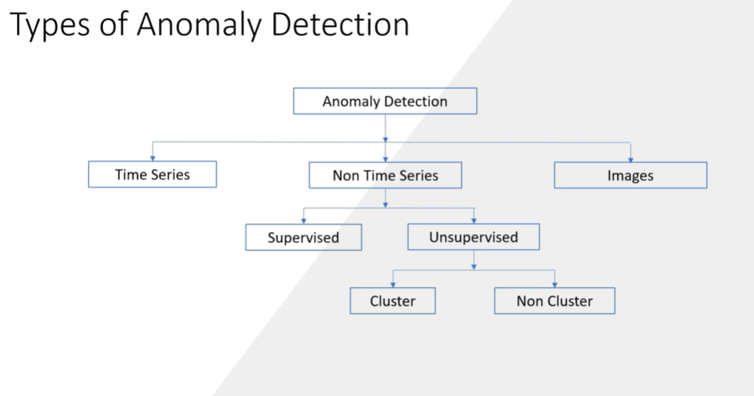

Slide 4
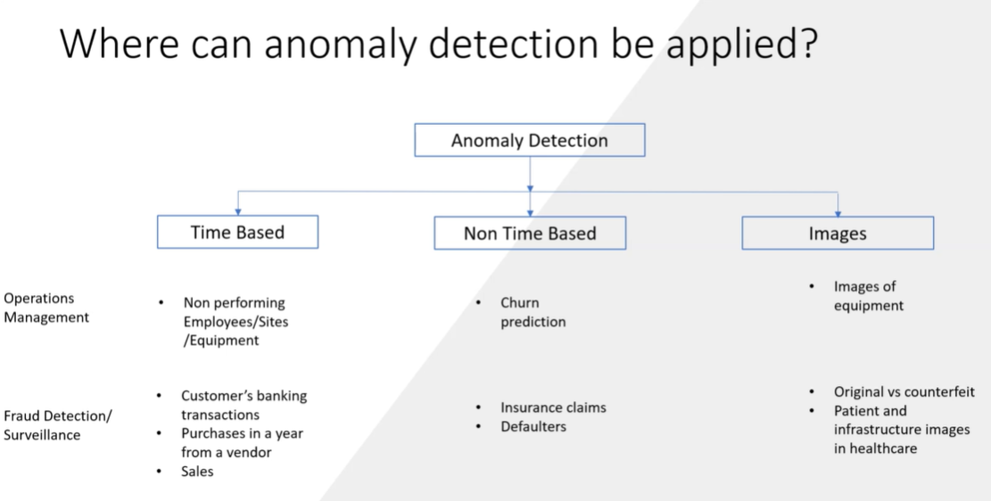

Slide 5
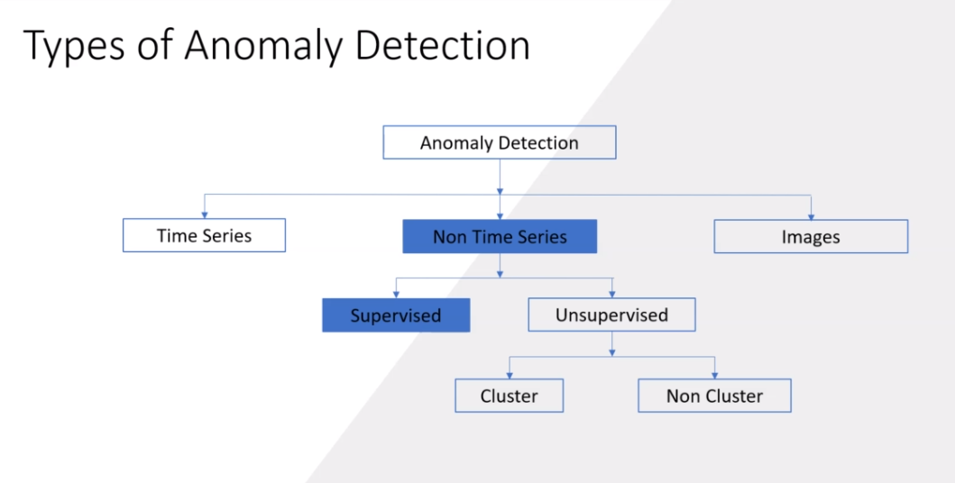

Slide 6
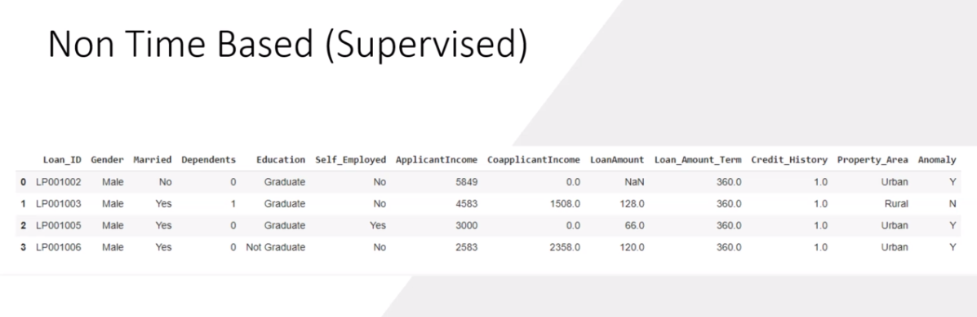

Slide 7
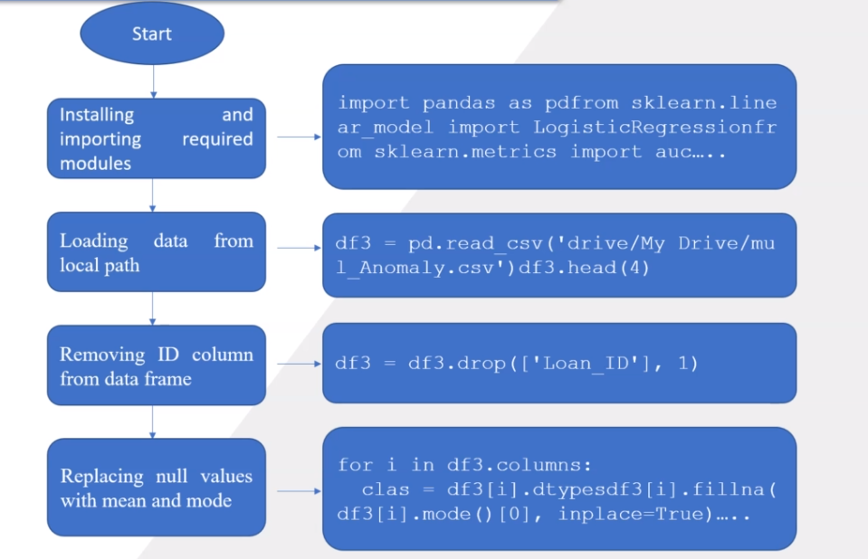

Slide 8
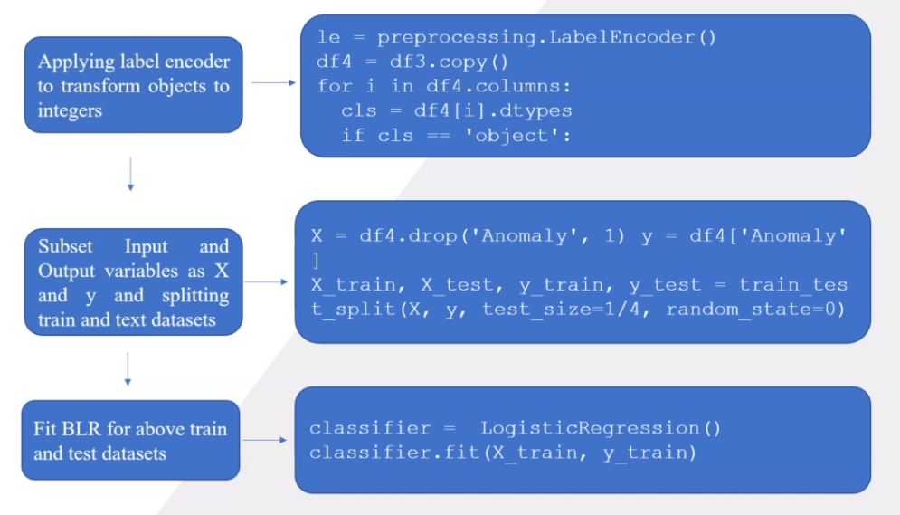

Slide 9
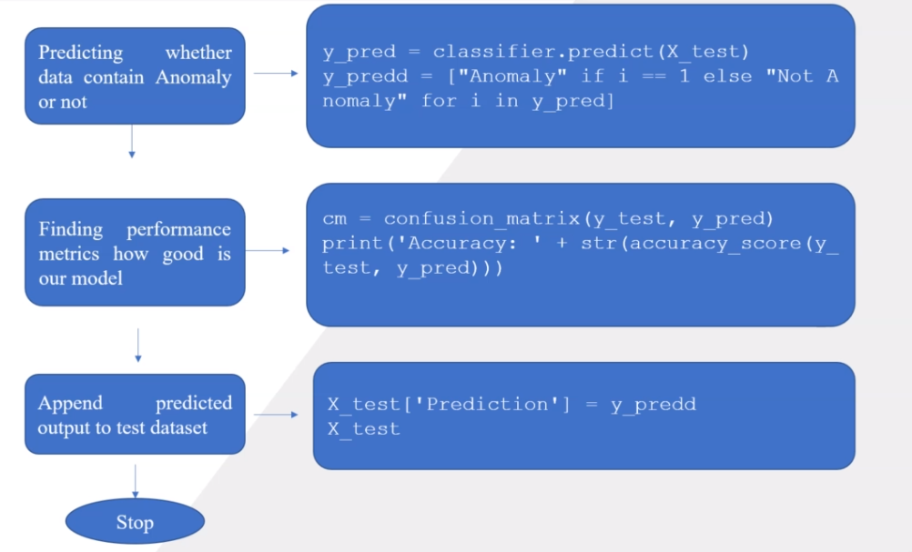

Slide 10
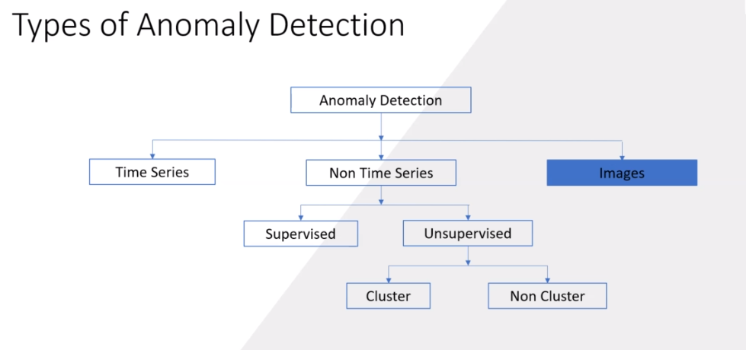
Image Anomaly Detection:

Slide 11
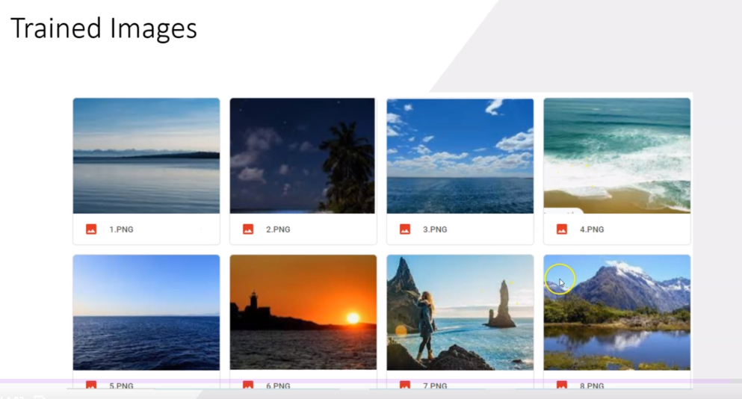

Slide 12
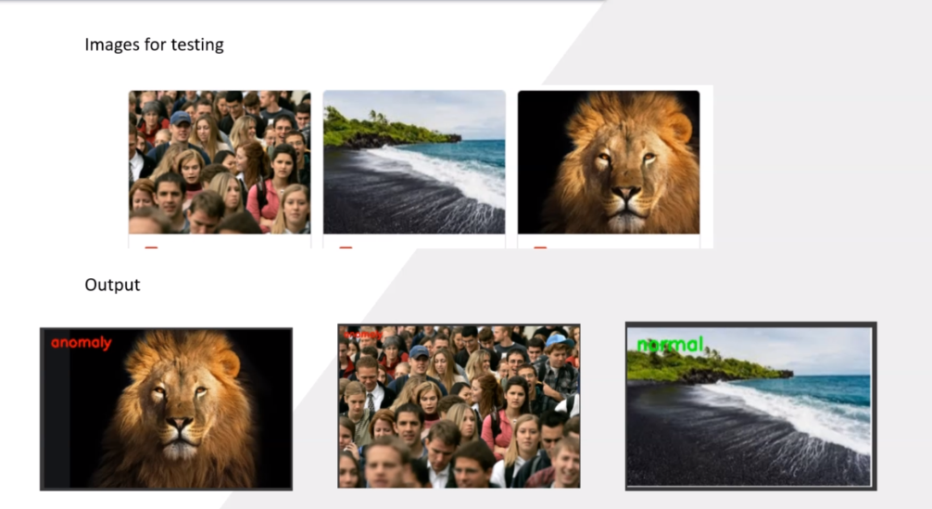
Example: Counterfeit currency, genuine products

Slide 13
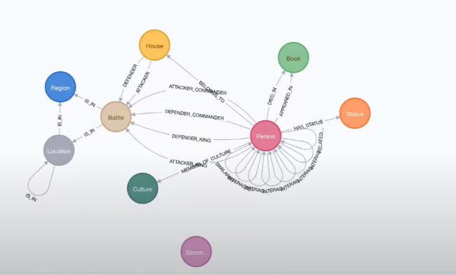
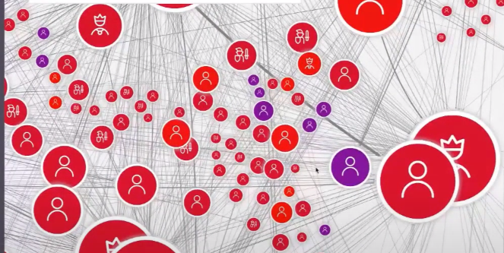
Graph Neural Networks:
GNN data will be added soon

Slide 14
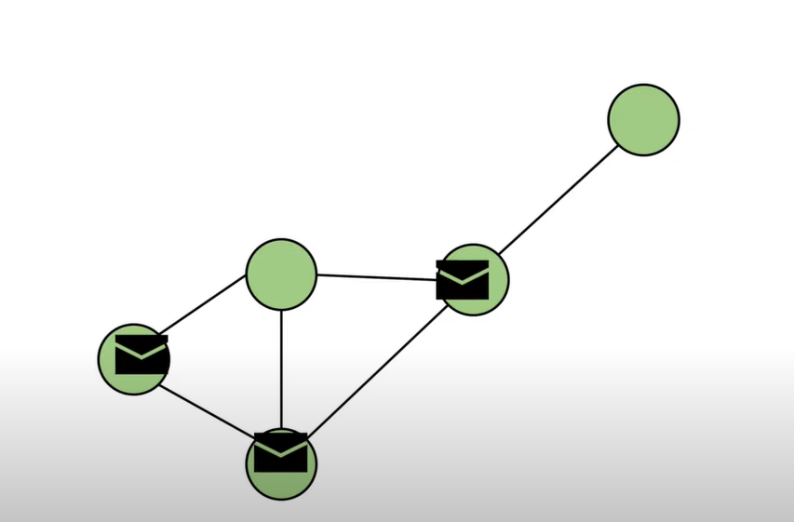
Nodes send the messages to other nodes and collects the messages from other nodes and updates itself.

Slide 15
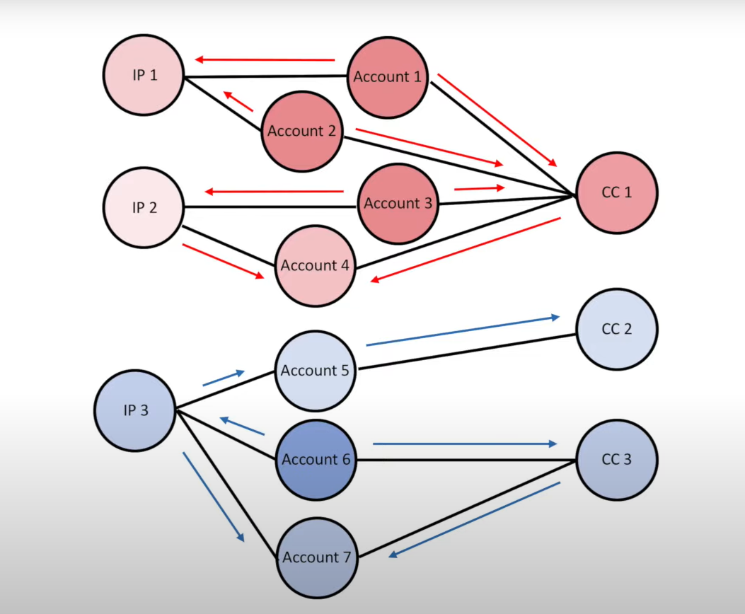

Slide 16
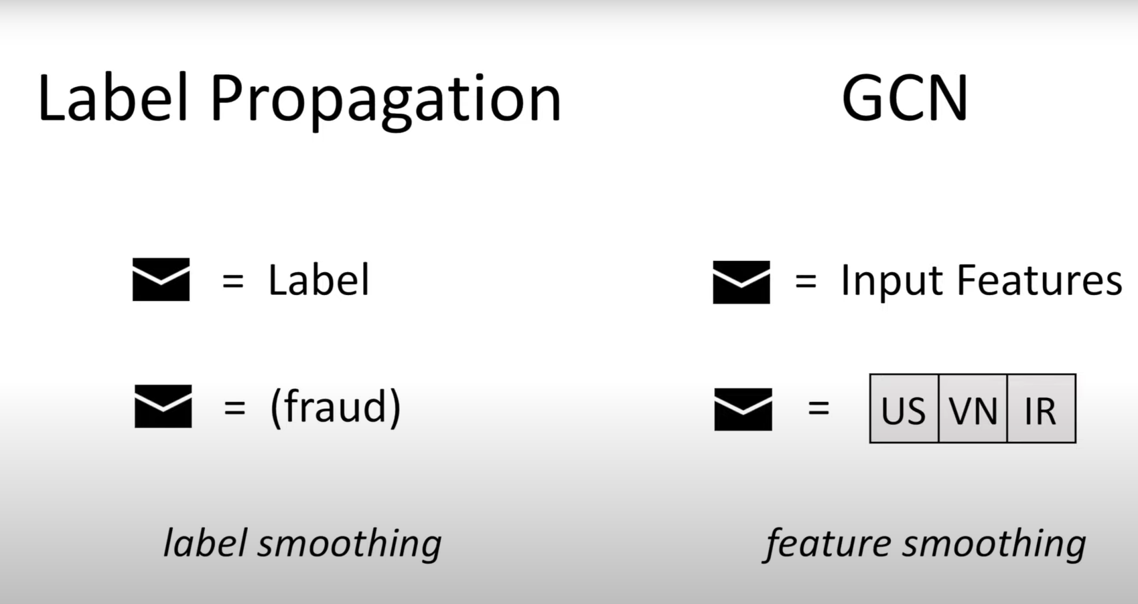

Slide 17
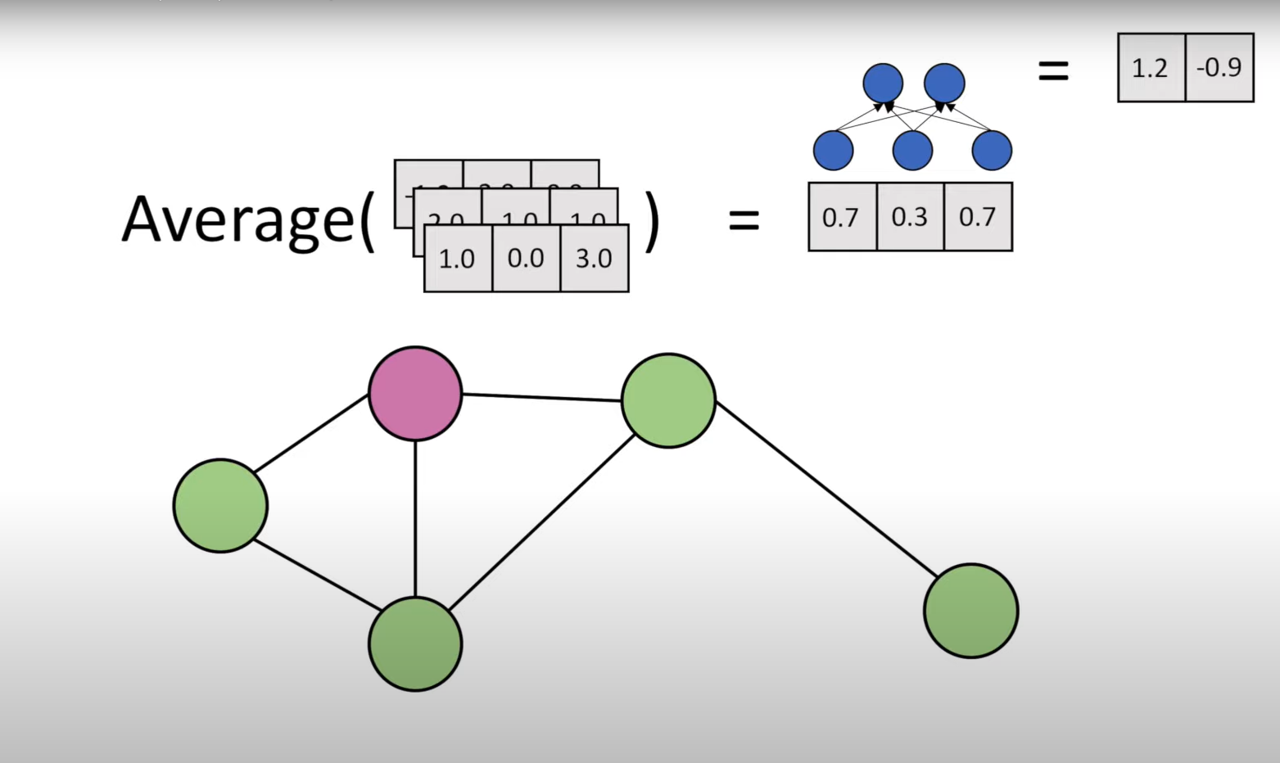

Slide 18
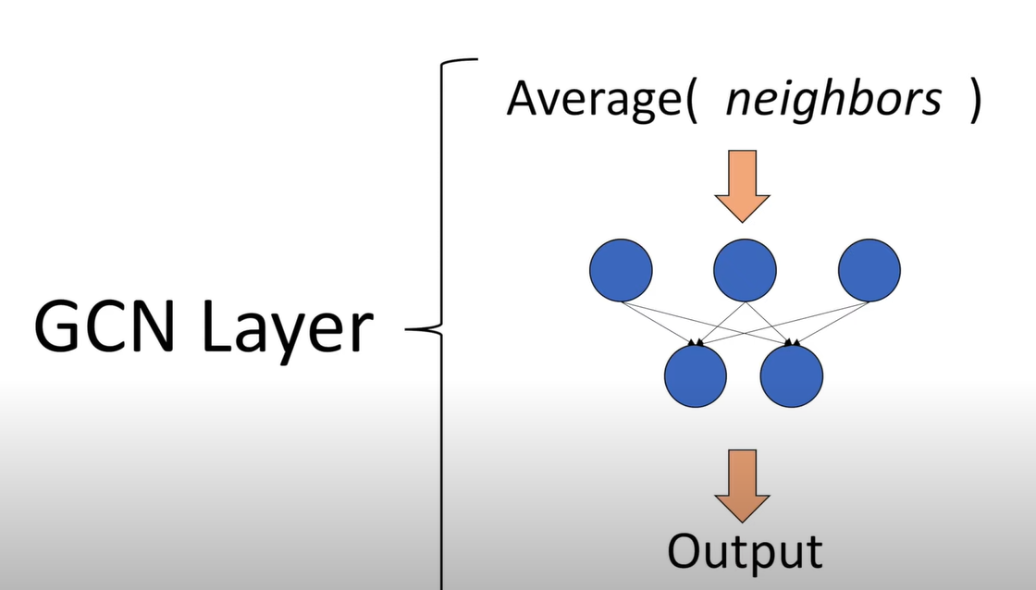

Slide 19
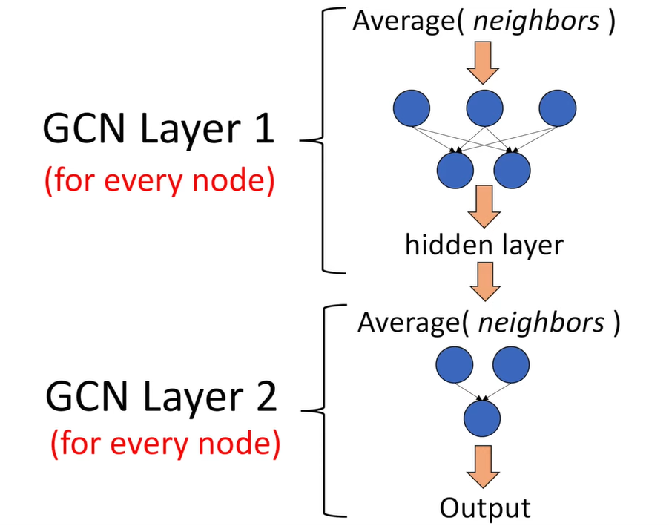

Slide 20
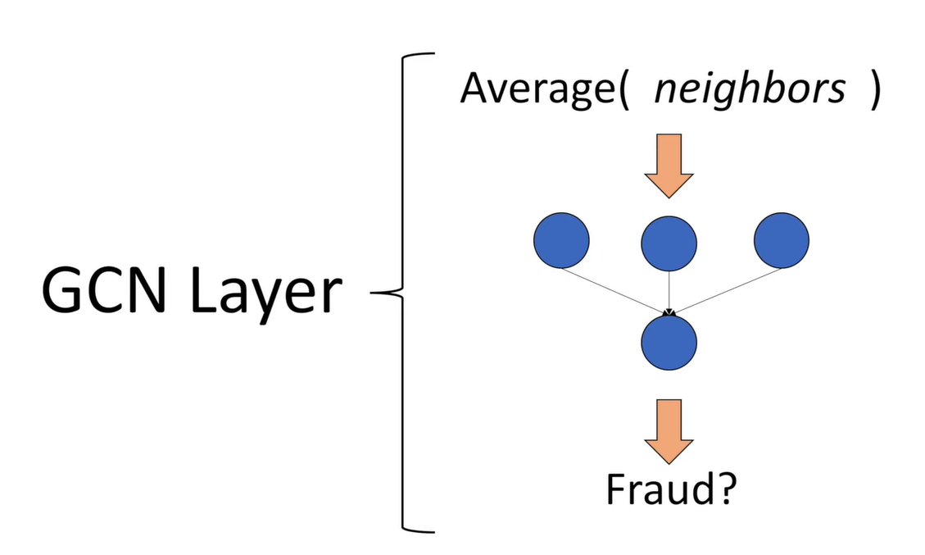

Slide 21
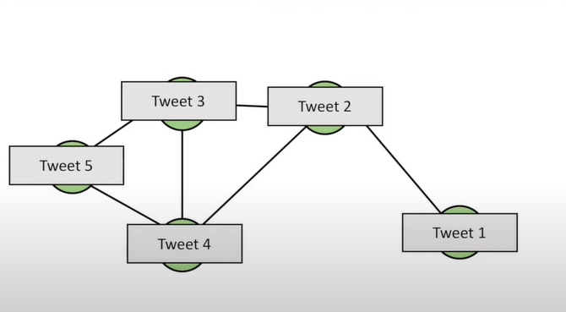

Slide 22
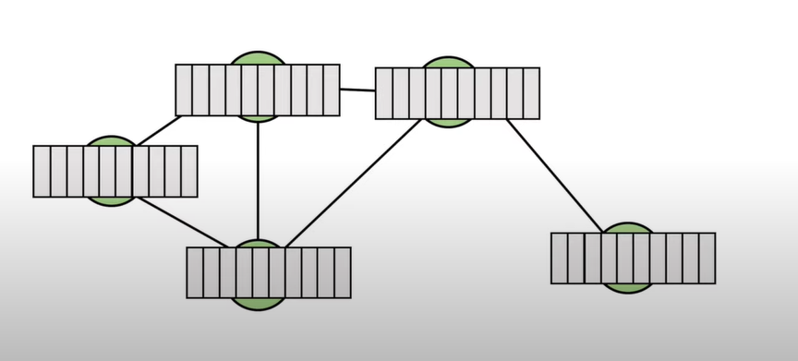

Slide 23
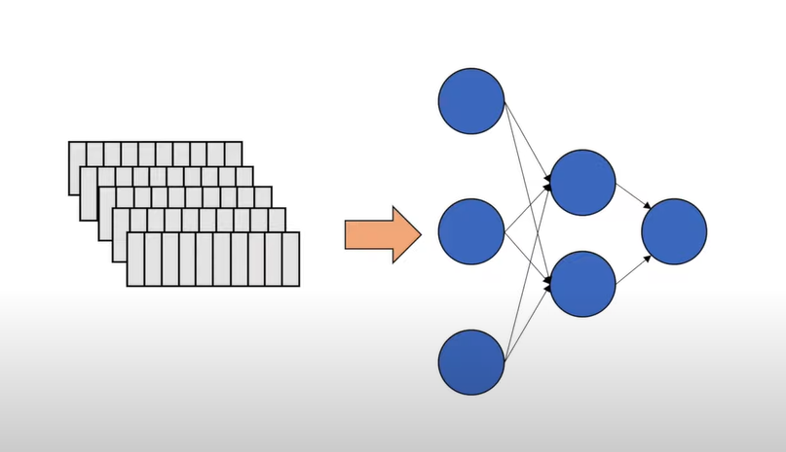

Slide 24
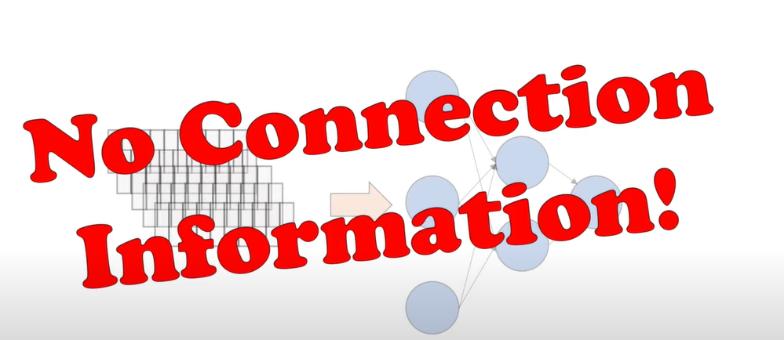

Slide 25
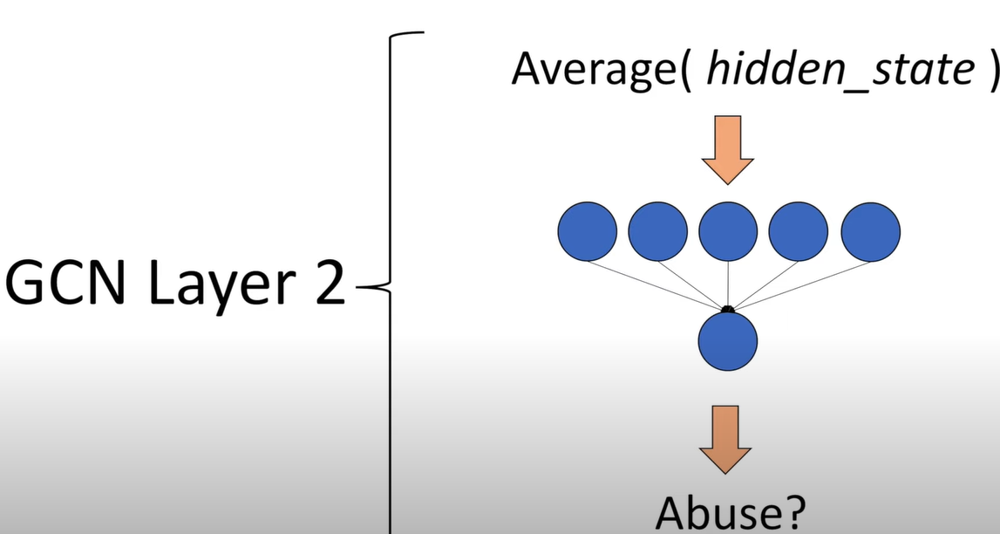

Slide 26
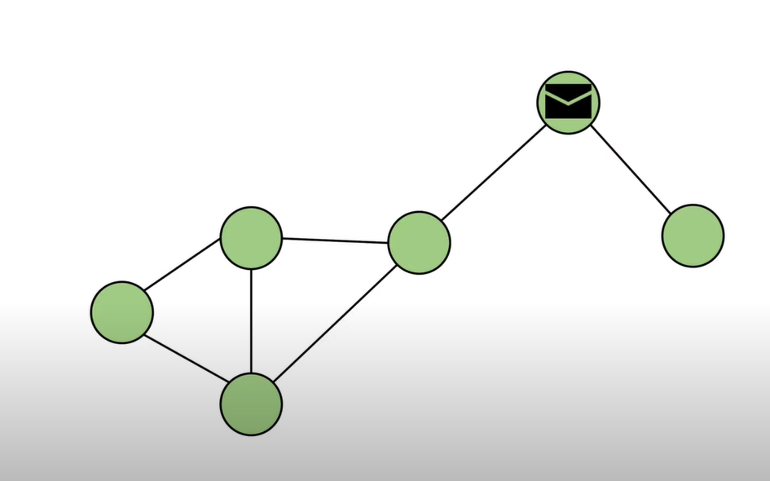

Slide 27
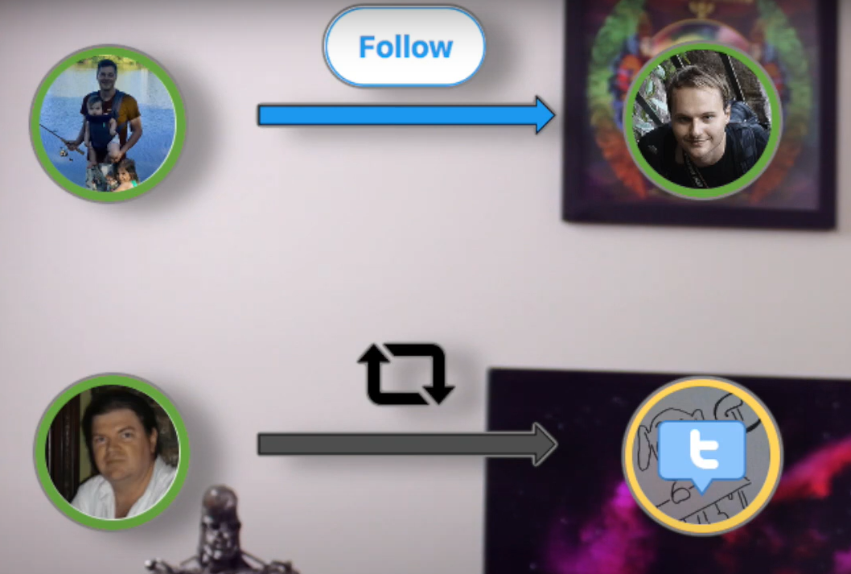
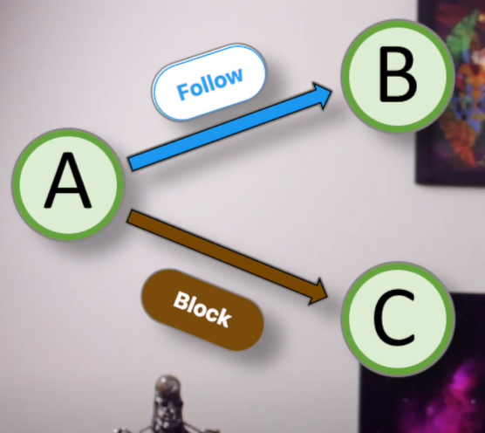
Relational GCN’s

Slide 28
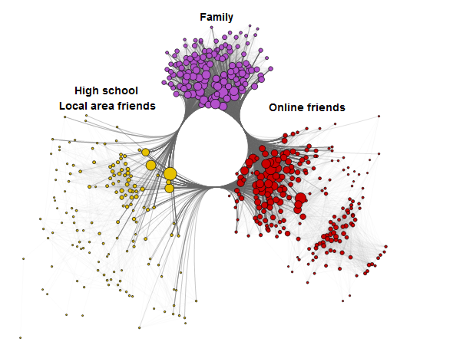

Slide 29
End of the session 2 ! Any Queries?

